Slide 1
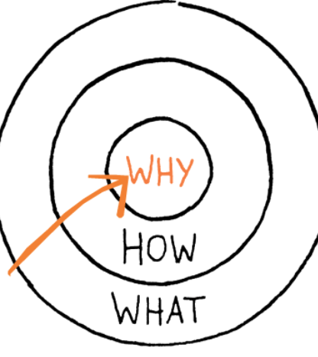
Part 1: Compelling Why of Personalized Learning

Slide 2
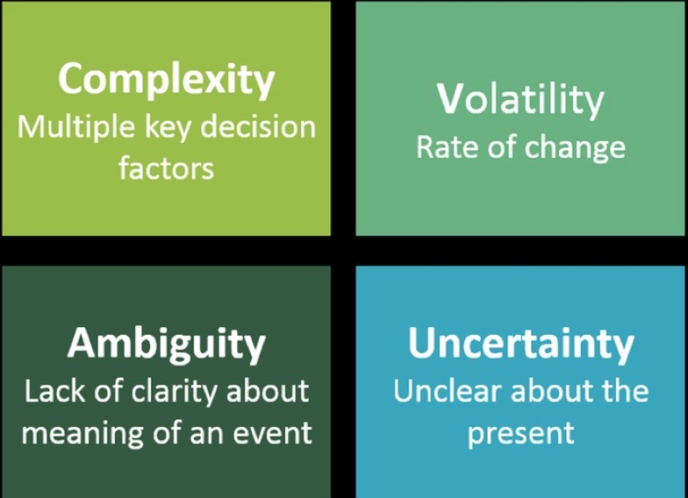
VUCA Volatile Uncertain Complex Ambiguous U.S. Army War College

Slide 3
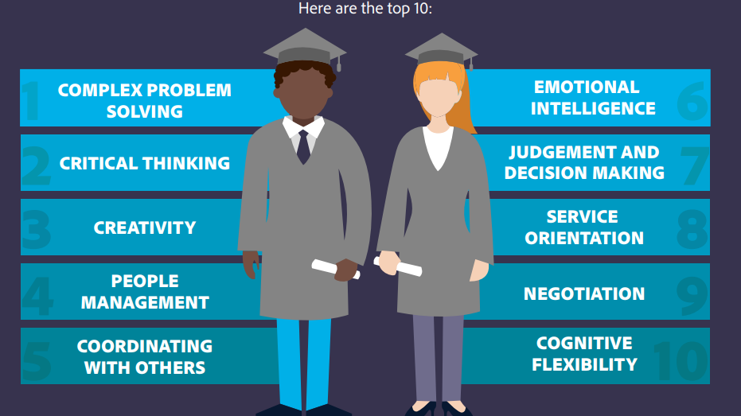
Notes:
World Economic Forum 2016

Slide 4
Pop Reflection
As you consider how the world has changed and the world of work has changed, how does that have impact on the way you are thinking about teaching and learning?

Slide 5
Part 2: Defining Key Terms and How it Connects to the Why

Slide 6
Contemporary Way of Imagining How to Do School
That honors:
State expectations
Community aspirations
Developmentally appropriate
Values the learning and the learner

Slide 7
Definition of Personalized Learning
Personalized learning is a progressively student-driven model where students deeply engage in meaningful, authentic, and rigorous challenges to demonstrate desired outcomes.
— Zmuda, Curtis, Ullman (2015)

Slide 8
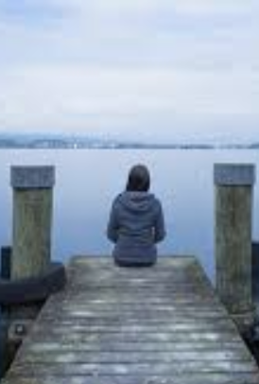
The Power of Story
Describe an experience which is highly personalized.
How did that experience match up with the key concepts in PL definition:
Self-driven
Authentic
Demonstrated desired outcomes
What other aspects from your story point to personalization?
Notes:
VUCA and time of uncertainty
Rewiring means that we are becoming more focused on storytelling (digging into our own experience more)

Slide 9
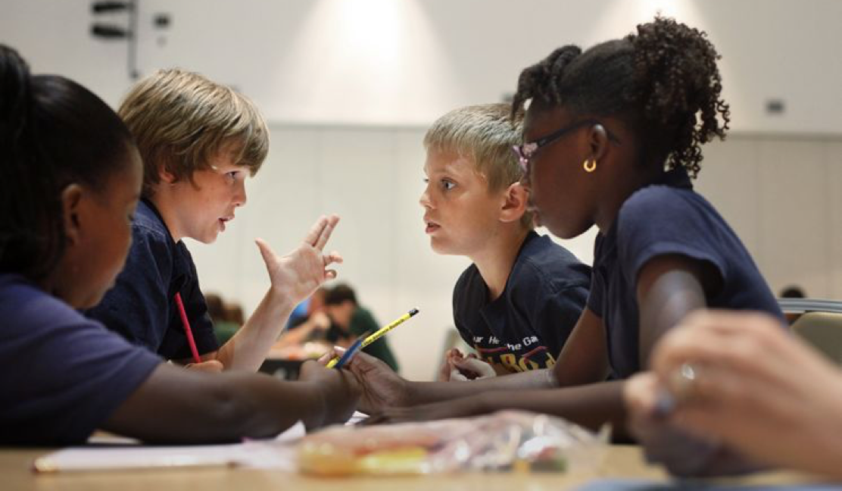
Definition of Habits of Mind
Characteristics of what intelligent people do when they are confronted with problems, the resolutions to which are not immediately apparent.
— Costa and Kallick (2008)

Slide 10
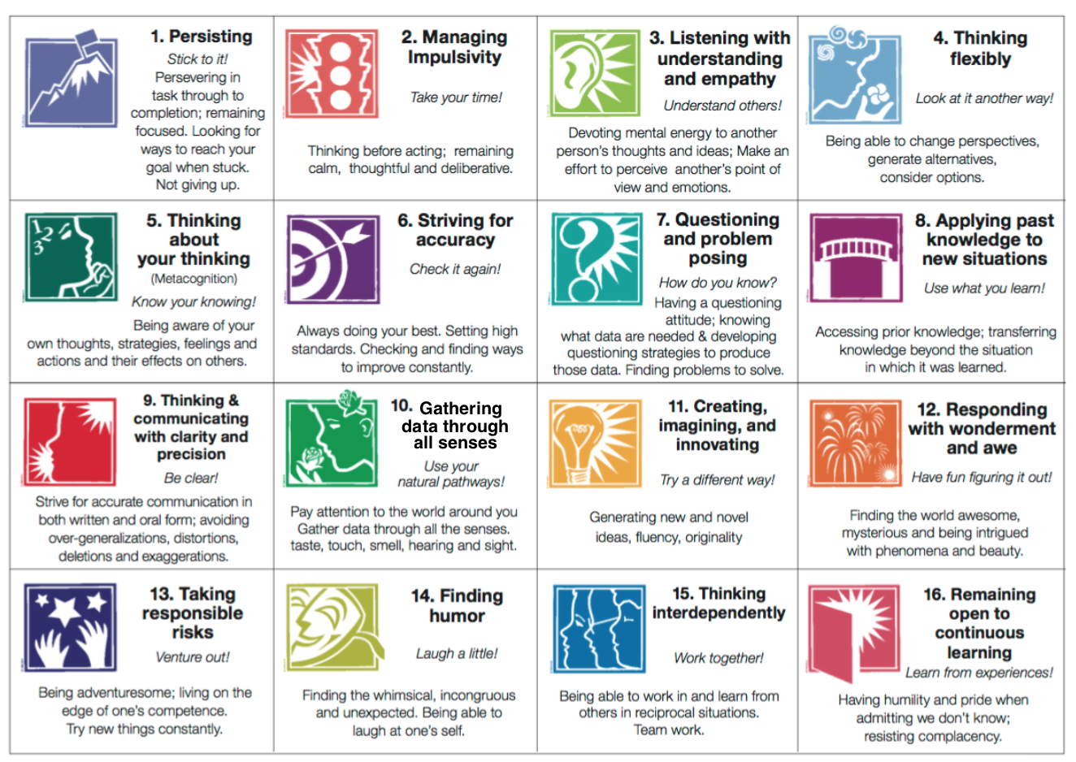

Slide 11
Returning to Your Storytelling Experience
How many of the Habits of Mind were in play — in your story or in your experience with one another?

Slide 12
How Personalizing Learning and Habits of Mind Fit Together
Describe actionable patterns of capacities and behaviors that can be learned and assessed
Transdisciplinary and transferrable — focused on enduring, essential learnings for the world we live in right now
As good for adults as they are for students

Slide 13
Related but Not a Synonym of Personalized Learning
INDIVIDUALIZATION | “I’m skeptical of personalized learning that is too much about kids spending a lot of time on computers marching through discrete tasks at their own pace… it pulls kids too often away from doing meaningful work and having meaningful interactions with peers, and it can value the individual needs over the idea that we’re all in this together.” — Ron Berger, EL Education
STUDENT controls the pace of the topic as well as when to demonstrate mastery.
Teacher/software platform drives instruction through tasks and related lesson plans.

Slide 14
Related but Not a Synonym of Personalized Learning
DIFFERENTIATION | “We need to help students take more ownership o their learning, which means that we need to own the work a little less.” — Mike Anderson, Author & Consultant
STUDENT selects from a range of content, process, and/or product options to meet the requirements.
TEACHER identifies appropriate choices for the range of students in the classroom to meet desired goals.

Slide 15
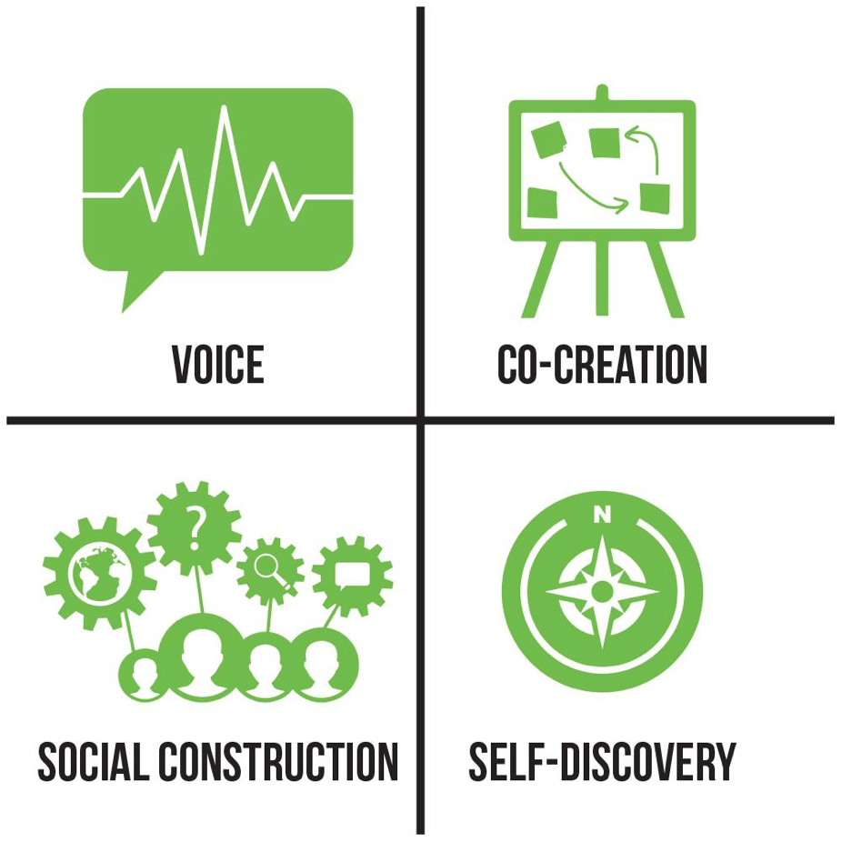
Four Attributes to Build Culture for Thinking

Slide 16
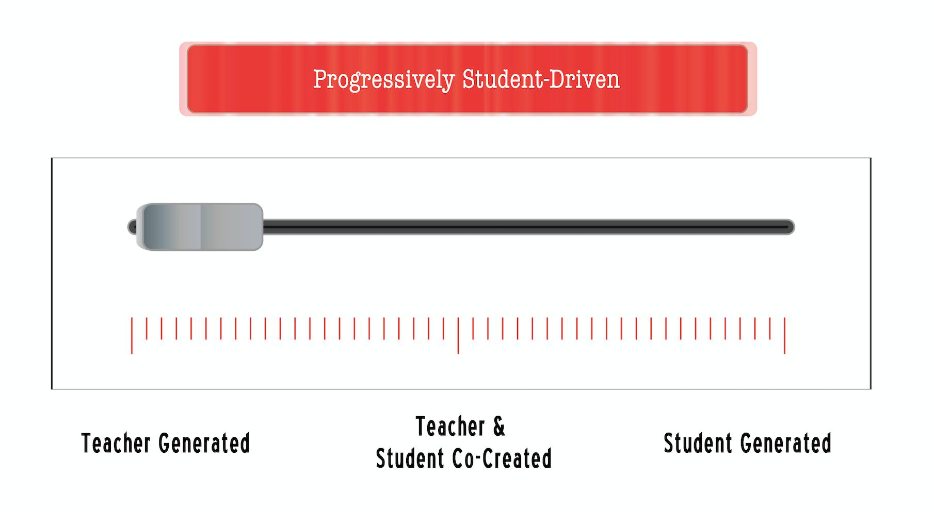
Part 3: Growing Learning & Learners by Design

Slide 17
Definition of Personalized Learning
Personalized learning is a progressively student-driven model where students deeply engage in meaningful, authentic, and rigorous challenges to demonstrate desired outcomes.
— Zmuda, Curtis, Ullman (2015)

Slide 19
Heat Map Example: Civil Rights
Students engage in original research and development (e.g., interviews, data analysis) to deepen understanding and promote action on a contemporary and meaningful civil rights issue. | Students wrestle with purpose of communication, select appropriate genre, and design presentation to connect with audience.
Students identify Civil Rights leader, event, or legislation and examine diverse and varied sources to summarize historical and modern day impact. | Students determine how to engage audience in a given genre (e.g., podcast, blog post, film) to present historical impact and contemporary legacy.
Students select from and research predefined Civil Rights leaders, events, legislation to summarize historical impact. | Students use a given medium and format (e.g., informative report, chronology) to present historical impact with supporting evidence.
DEPTH AND COMPLEXITY OF DESIGN | AUTHENTICTY MATCHING PURPOSE & AUDIENCE

Slide 20
Examples to Review
Film from two high school students on Ella Baker
Example from 5th grade classroom on examining Civil Rights from multiple perspectives in preparation to write a fictional narrative
High school students designed Civil Rights Tour of Grand Rapids with podcasts at each of the twelve stops.
As you are exploring one of these examples, consider:
Where might it fall on the heat map?
In what ways do you see evidence of personalization?
Voice, Co-Creation, Social Construction, Self-Discovery
Self-driven, authentic, desired outcomes

Slide 21
Challenges to Balance in Design
Structure and Freedom
Destination and Exploration
Predictability and Risk Taking

Slide 22
Taking It Out for a Test Drive: Develop a Heat Map for this Idea
Launch idea to describe voter suppression in the 2018 mid-term election and proposed actions to research
10 minutes: reading and annotating text
10 minutes: conversation to make sense and sketch out ideas for students to engage with
10 minutes: apply one idea to Heat Map

Slide 23
Reflection
I used to think … and now I think
An example that helped me was…
The question that is still on my mind is…

